Slide 1
Microsoft Power Automate Empowerment
Notes:
Hi, Welcome to Microsoft Power Platform + Dynamics 365 Bootcamp.

Slide 2
Course Overview
Day 1
Empowering everyone with Power Platform
Day 2
Power Automate Introduction
Day 3
Power Automate Project Scenarios
Day 4
Monitoring & Administration of Power Automate
Introduction to Power Platform
Microsoft Power Platform momentum
Why Power Platform?
Customer Stories
Power Platform Components Demo
Power Platform Account Setup
Microsoft Flow Basics
Microsoft Flow Templates
Decision Making with Flow
Conditions, Switches, Scope & Context of Decision-Making Control Elements
Building Workflows with Power Automate
Hands on Lab - Microsoft Flow
Approve / Reject Workflow Scenario
Recurrence Workflow Scenario
Errorless workflows Scenario
Build and Implement Custom Connector
Azure Cognitive Services AI Integration Workflow Scenario
Power App Integration Workflow Scenario
SQL Server Integration Workflow Scenario
HoL - End to End Business Flow with all Scenarios
UI Flows
Import, Export Flows
Distribute Flows
Sharing of Flows across workspaces
Different Flow Environments and Code Promotion
Data Policies & Integration Check Points
Flow History and Analytics
HoL - Check your Knowledge

Slide 3
Day4: Monitoring & Administration of Power Automate

Slide 4

Agenda
UI Flows
Import, Export Flows
Distribute Flows
Sharing of Flows across workspaces
Different Flow Environments and Code Promotion
Data Policies & Integration Check Points
Flow History and Analytics
HoL - Check your Knowledge

Slide 5
AN OVERVIEW OF MICROSOFT POWER PLATFORM ARCHITECTURE

Slide 6
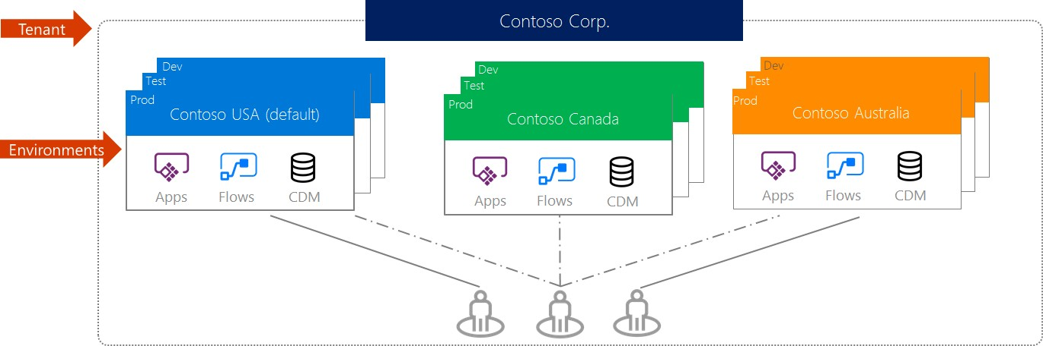
Know your environments
Environments are containers that administrators can use to manage apps, flows, connectors and other assets, along with permission to allow organization users to use the resources.
Notes:
https://support.microsoft.com/en-in/help/4513676/differences-between-flow-approval-actions

Slide 7
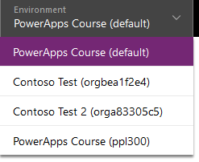
Know your environments
Environments are tied to a geographic location that is configured at the time the environment is created.
Environments can be used to target different audiences and/or for different purposes such as dev, test and production.
Every tenant has a default environment, created automatically
Common Data Service for Apps (CDS) databases are created in the context of environments; one per environment.
Notes:
https://support.microsoft.com/en-in/help/4513676/differences-between-flow-approval-actions

Slide 8
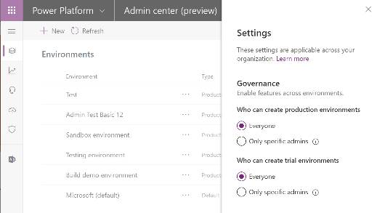
Environment key facts
Environments are tied to a geographic location that is configured at the time the environment is created
Environments can be used to target different audiences and/or for different purposes such as dev, test and production
Every tenant has a Default environment where all licensed Power Apps and Power Automate users can create apps & flows
Non-default environments offer more control around permissions
Non-default environment creation can be restricted to only global and service admins from the Power Platform admin center: https://aka.ms/ppac
Notes:
For data residency concerns, envs are tied to geographic location
Every tenant has a default environment, created automatically.
Additional envs for DevOps, for permission reasons
Full control over who can create those environments
Control who can create and manage environments in the Power Platform Admin center: https://docs.microsoft.com/en-us/power-platform/admin/control-environment-creation

Slide 9
Types of environments
Type | Description
Trial | Expire after 30 days, limit 1 per user
Developer | One per user - community program – single user http://aka.ms/powerappcommunityplan
Default | Every tenant has one default environment – useful for personal productivity assets
Sandbox | Non-production environment enables some additional options like copy and reset
Production | Non-expiring full environment
Notes:
Developer environment is created whenever a user signs-up for the PowerApps community plan - http://aka.ms/powerappcommunityplan, can’t restrict unless with service ticket
Production environments can be created by any licensed user as long as there is 1GB of remaining storage capacity

Slide 10
Establish an environment strategy
Assign your admins the Power Platform service admin role, which grants full access to Power Apps, Power Automate, & PowerBI
Restrict the creation of net-new trial and production environments to admins
Treat the default environment as a ‘Personal productivity’ environment for your business groups (renaming the environment is recommended)
Establish a process for requesting access or creation of environments
Dev/Test/Production environments for specific business groups or applications
Individual-use environments for POCs and trainings
Notes:
Default for people to get started, build apps for their teams
https://powerapps.microsoft.com/en-us/blog/establishing-an-environment-strategy-for-microsoft-power-platform/

Slide 11
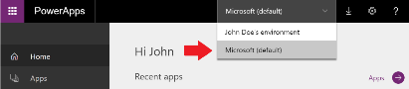
Default Environment
Automatically created with first user in the region closest to the Azure AD tenant
New users that sign up for Power Apps automatically added to the Maker role
Users are not automatically added to the Environment Admin role
The default environment can’t be deleted, but you can rename it – e.g. Personal Productivity

Slide 12
Power Platform Environments are built on Azure
PowerApps Default Environment
PowerApps
Flows
Azure AD Microsoft Azure
Logic Apps Management API
Functions Storage

Slide 13
Office 365 Tenant and Default Environment
Office 365
Tenant
PowerApps Default Environment
PowerApps
Flows
Azure AD Microsoft Azure
Logic Apps Management API
Functions Storage
Notes:
There are no limitations to the number of apps or flows that can be deployed within an environment
Gateways, which leverage a common service that spans Power platform (& includes PowerBI), are enabled, by default, only in the default environment
There is a process (initiated via support ticket) for manually migrating a gateway to a non-default environment.
We plan to provide a self-service way to support gateways in non-default environments by April 2019.

Slide 14
Default Environment embedded connections
Office 365
Tenant
PowerApps Default Environment
SharePoint
PowerApps
Teams
Flows
Exchange
Excel
Azure AD Microsoft Azure
Logic Apps Management API
Functions Storage

Slide 15
Environment Permissions in Default
Office 365
Tenant
PowerApps Default Environment
SharePoint
PowerApps
Teams
Flows
Exchange
Makers: All Licensed Users: None
Excel
Azure AD Microsoft Azure
Logic Apps Management API
Functions Storage

Slide 16
Using On Premise Data
Office 365
Tenant
PowerApps Default Environment
SharePoint
PowerApps
Teams
Flows
Exchange
Makers: All Licensed Users: None
Excel
Azure AD Microsoft Azure
Logic Apps Management API
Functions Storage
Data
Gateway(s)
On Premise Gateway(s)
Databases
Web API
SharePoint Data
File Storage
On Premise Systems

Slide 17
Example environment strategy
Production
Envs
Live applications - could be shared when common data or dedicated for department / line of business
ALM
Envs
Used to support Dev ops automation – often these will exist for short period during execution
Default
Renamed Personal Productivity – used as the default place everyone creates their own user assets
Maker Envs
Used to support makers building apps – these might be requested via an approval process
Notes:
pMopao

Slide 18
Provisioning New Environments
Office 365
Tenant
PowerApps Default Environment
PowerApps Environment (no CDS)
PowerApps Environment (with CDS)
Active
Directory
SharePoint
PowerApps
Canvas Apps
Canvas Apps
Model Driven Apps
Teams
Flows
Flows
Flows
Business Process Flows
Exchange
AD Managed Makers: Admin Users: None
Managed by CDS (AD Groups) Environment Admin: Creator Environment Makers: None System Customizer: None
CDS User: None
Makers: All Licensed Users: None
Excel
Azure AD Microsoft Azure
Logic Apps Management API
Functions Storage
Data
Gateway(s)
On Premise Gateway(s)
Databases
Web API
SharePoint Data
File Storage
On Premise Systems
Notes:
There are no limitations to the number of apps or flows that can be deployed within an environment
Gateways, which leverage a common service that spans Power platform (& includes PowerBI), are enabled, by default, only in the default environment
There is a process (initiated via support ticket) for manually migrating a gateway to a non-default environment.
We plan to provide a self-service way to support gateways in non-default environments by April 2019.

Slide 19
Data Loss Prevention
Office 365
Tenant
PowerApps Default Environment
PowerApps Environment (no CDS)
PowerApps Environment (with CDS)
Active
Directory
SharePoint
PowerApps
Canvas Apps
Canvas Apps
Model Driven Apps
Office
Connector
Connector
DLP
Flows
Flows
Flows
Connector
DLP
DLP
Business Process Flows
DLP
Exchange
Managed by CDS (AD Groups) Environment Admin: Creator Environment Makers: None System Customizer: None
CDS User: None
Makers: All Licensed Users: None
AD Managed Makers: Admin Users: None
Excel
Azure AD Microsoft Azure
Logic Apps Management API
Functions Storage
Data
Gateway(s)
On Premise Gateway(s)
Databases
Web API
SharePoint Data
File Storage
On Premise Systems
Notes:
There are no limitations to the number of apps or flows that can be deployed within an environment
Default environment can also now have a CDS database
Gateways, which leverage a common service that spans Power platform (& includes PowerBI), are enabled, by default, only in the default environment
There is a process (initiated via support ticket) for manually migrating a gateway to a non-default environment.
We plan to provide a self-service way to support gateways in non-default environments by April 2019.

Slide 20
SECURING YOUR ENVIRONMENTS

Slide 21

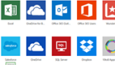
The 5 layers of security
Contoso Corp.
1. Azure AD Conditional Access
Dev
Contoso EMEA (default)
Test
Contoso EMEA (default)
Prod
Contoso USA
2. Environment roles
3. Resource permissions for apps, flows, custom connectors…
PowerApps
Flows
CDS
PowerApps
Flows
CDS
Power Apps
Power Automate
4. CDS security roles
CDS
5. Cross-tenant inbound & outbound restrictions to the 300+ connectors to cloud services, content services, DBs, APIs, etc.
Notes:
PowerApps and Flow do not provide users with access to any data assets that they don’t already have access to. Users should only have access to data that they really require access to.

Slide 22
The 5 layers of security + the one that maters most
Contoso Corp.
1. Azure AD Conditional Access
Secure your data at rest
There is no such thing as security through obscurity
Power Apps and Power Automate do not provide users with access to any data assets that they don’t already have access to.
Users should only have access to data that they really require access to.
Dev
Contoso EMEA (default)
Test
Contoso EMEA (default)
Prod
Contoso USA
2. Environment roles
3. Resource permissions for apps, flows, custom connectors…
PowerApps
Flows
CDS
PowerApps
Flows
CDS
Power Apps
Power Automate
4. CDS security roles
CDS
5. Cross-tenant inbound & outbound connector restriction
Notes:
PowerApps and Flow do not provide users with access to any data assets that they don’t already have access to. Users should only have access to data that they really require access to.

Slide 23
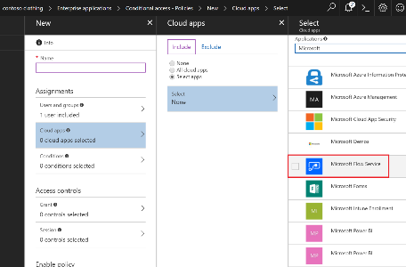
#1 - Conditional service access
Azure AD Premium required
Scenario coverage
Grant/block access based upon
User/Group
Device
Location

Slide 24

#2-4 Environment security and access control
Access is controlled at three levels
Environment roles
Resource permissions for apps/flows/custom connectors/etc.
CDS security roles (if a CDS database has been provisioned)
Once a CDS database has been created, the CDS security roles take over for controlling security
Env (no CDS)
Environment Roles (Maker/Admin)
App
Flow
Resource Permissions
(Owner/Contributor/User…)
Custom Connector
Env (w/ CDS)
Environment Roles (Maker/Admin)
App
Flow
Resource Permissions
(Owner/Contributor/User…)
Custom Connector
Env & CDS Roles
(Maker/Admin/Customizer…)
Common Data Service
Notes:
All env admins and makers are migrated

Slide 25
Security with CDS in an environment
Users are associated with an environment either directly or the-just in-time via an Azure AD Group
Access to apps, data and services is by association with one or more security roles
Each security role grants discrete privileges
Data can be secured down to the field level

Slide 26
Key out-of-box security roles you need to know
Role | Description
Environment Admin / System Administrator | Complete ability to customize and administer the environment. Full read-write access to data in the database. The role cannot be modified. Care should be taken in assigning this to the right people.
System Customizer | Full permission to customize the environment. Data access is focused only on data owned by the user. Role can be modified but it is not recommended to modify.
Environment Maker | Create new resources in the environment including apps, connections, gateways and flows. There is no default privileges to data included. Role can be modified but it is not recommended to modify.
Common Data Service User | Basic user role, with ability to run apps and perform common tasks but no ability to customize the system. The data access is focused on Read access to most Common Data Model core entities with full access to records owned by the user (i.e. ‘self’ privileges). Good role to copy to make a custom security role for users.

Slide 27
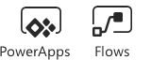
#5 Cross-tenant inbound & outbound restrictions
Default Configuration
Contoso User can establish
a connection using Fabrikam credentials
Fabrikam user can establish a connection
using Contoso credentials
Customer Tenant
Contoso
3rd Party Tenant
Fabrikam
Notes:
https://aka.ms/adtenantrestrictions

Slide 28
Cross Tenant Access – Restrict outbound
https://aka.ms/adtenantrestrictions => this applies to all Azure AD Cloud SaaS app
Contoso User is blocked from connecting using Fabrikam credentials
Fabrikam user can establish a connection
using Contoso credentials
Customer Tenant
Contoso
3rd Party Tenant
Fabrikam
Notes:
https://aka.ms/adtenantrestrictions

Slide 29
Cross Tenant Access – Restrict inbound
Requires support ticket today => this restriction only applies to Power Apps and Power Automate
Contoso User can establish
a connection using Fabrikam credentials
Fabrikam user is blocked connecting
using Contoso credentials
Customer Tenant
Contoso
3rd Party Tenant
Fabrikam
Notes:
https://aka.ms/adtenantrestrictions

Slide 30
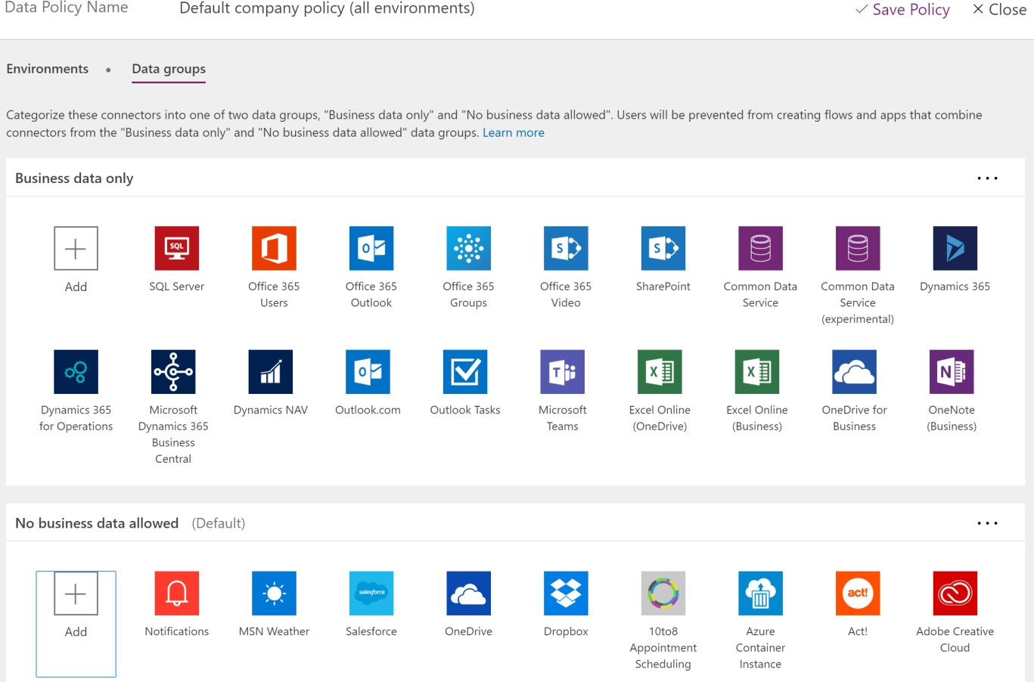
Prevent data leakage with DLP policies
Data loss prevention policies (DLP) enforce rules for awhich connectors can be used together by classifying connectors as either Business Data only or No Business Data allowed.
Simply, if you put a connector in the business data only group, it can only be used with other connectors from that group in the same app.
Tenant admins can define policies that apply to all environments

Slide 31
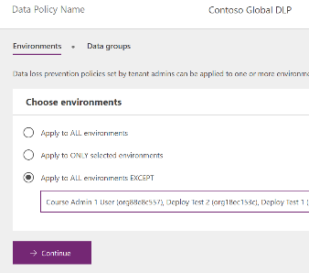
Applying to environments
Multiple policies can apply to an environment
The most restrictive policy applies to the combination of connectors
Use ONLY selected and EXCEPT to tailor which environments are impacted

Slide 32
Setup data loss prevention (DLP) policies
Create a policy spanning all environments that blocks all unsupported non-Microsoft connectors and classifies all Microsoft connectors as ‘Business Data’
#1: Block unsupported non-Microsoft connectors (e.g. Dropbox, social media)
Default
Training #1
Training #2
Dev
Dev
Test
Test
Prod
Prod
Contoso Europe
Contoso USA

Slide 33
Setup data loss prevention (DLP) policies
Create a policy spanning all environments that blocks all unsupported non-Microsoft connectors and classifies all Microsoft connectors as ‘Business Data’
Create a policy for the default environment (and other training environments) that further restricts which Microsoft connectors are classified as ‘Business Data’
#1: Block unsupported non-Microsoft connectors (e.g. Dropbox, social media)
#2: Restrict ‘business data’ connectors (e.g. only Office 365 connectors are business data)
Default
Training #1
Training #2
Dev
Dev
Test
Test
Prod
Prod
Contoso Europe
Contoso USA
Notes:
Applies to all environments that aren’t your managed environments
Put Office into business and Azure into non-business

Slide 34
Setup data loss prevention (DLP) policies
Create a policy spanning all environments that blocks all unsupported non-Microsoft connectors and classifies all Microsoft connectors as ‘Business Data’
Create a policy for the default environment (and other training environments) that further restricts which Microsoft connectors are classified as ‘Business Data’
Create additional policies or exclude those environment from policies #1 and #2 above that permit certain connectors or connector combinations to be used for specific environments
#1: Block unsupported non-Microsoft connectors (e.g. Dropbox, social media)
#2: Restrict ‘business data’ connectors (e.g. only Office 365 connectors are business data)
#3: Create exception policies for certain application environments
Default
Training #1
Training #2
Dev
Dev
Test
Test
Prod
Prod
Contoso Europe
Contoso USA

Slide 35
Monitor

Slide 36
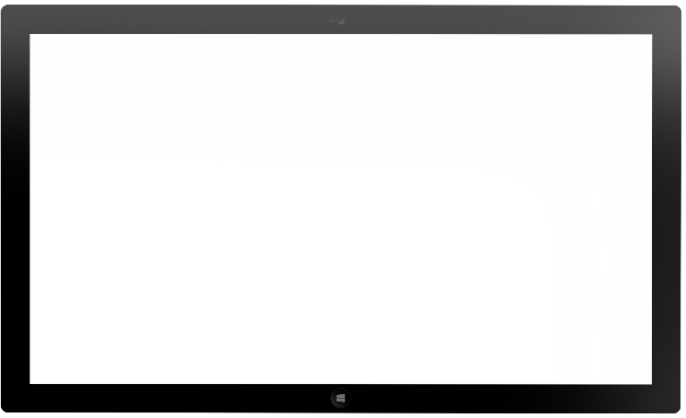
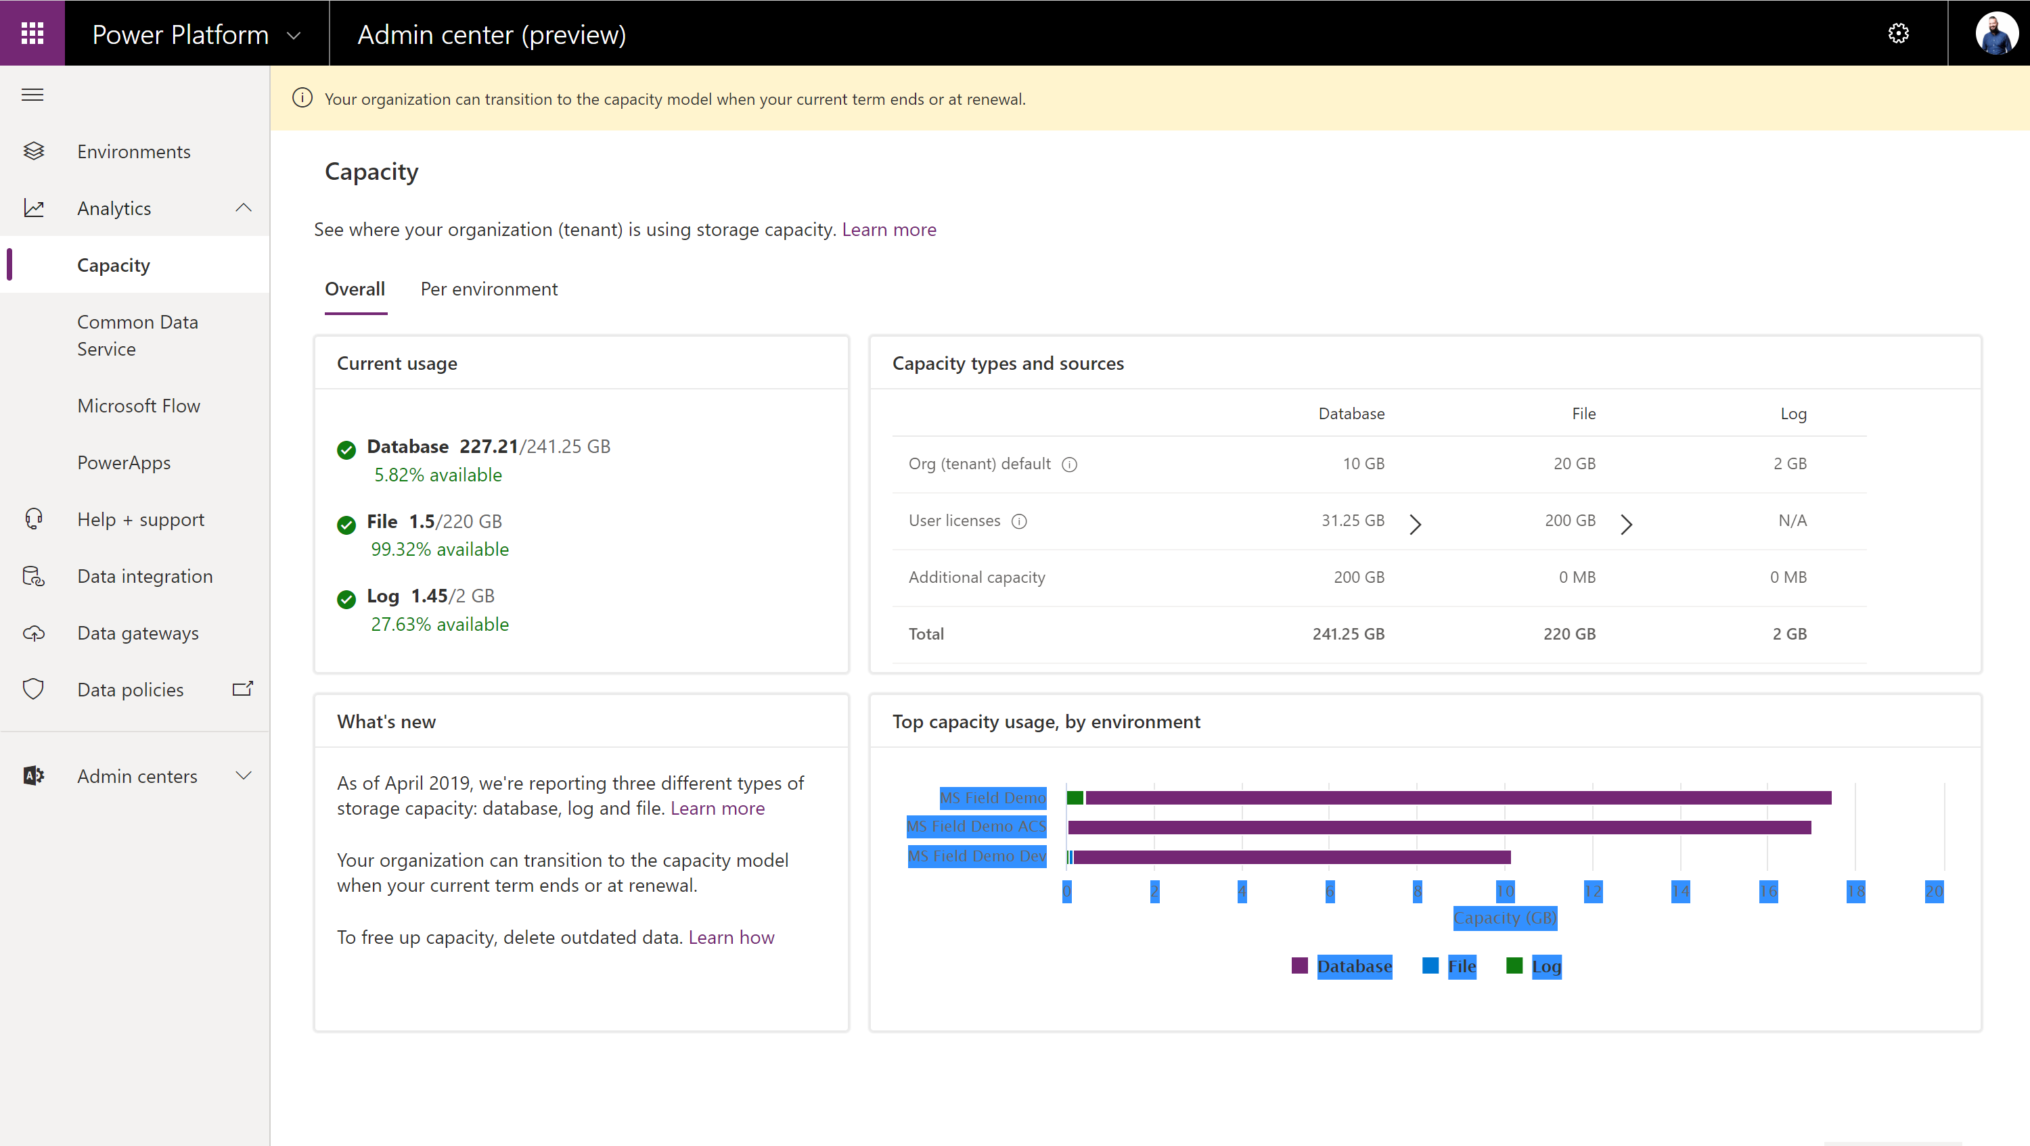
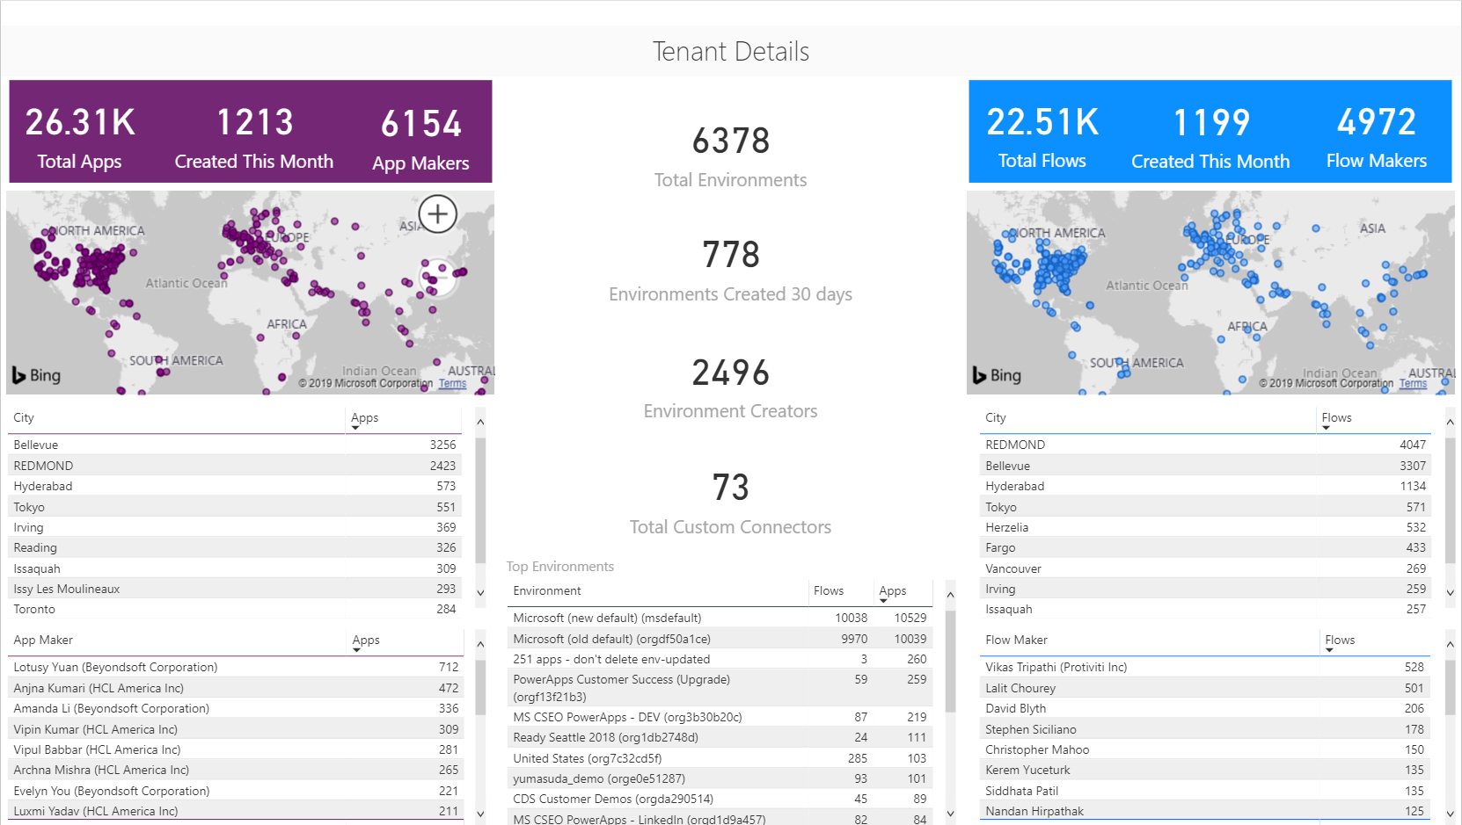
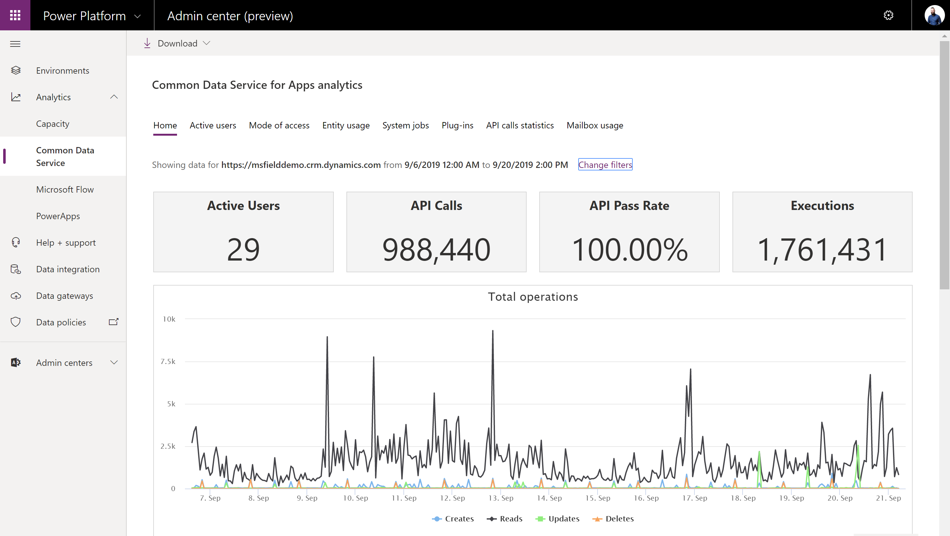
Admin reporting and analytics in the Power Platform admin center
Admin insights provide deep visibility into usage and performance of applications
Users
Locations
Capacity
Personalize insights and drive action with custom Power BI reports and Power Automate
All up view of what’s being created
Discover your champions
Trigger automated actions
Analytics track health and implementation metrics and help keep users on track
Service performance
Error reporting
App usage

Slide 37

Logs & analytics – see what’s happening
Power Apps and Power Automate logs available at https://protection.office.com/
Activity Logging integrated with Office Security and Compliance center for comprehensive logging across Microsoft services.
The audit records are stored in Office 365 Security and Compliance center. Must have an Office 365 E3 or greater license Must enabled at the organization level
Office provides an API to query this data, which is currently used by many SIEM vendors to use the Activity Logging data for reporting
Power Automate | Power Apps
Created flow Edited flow Deleted flow Edited permissions Deleted permissions Started a paid trial Renewed a paid trial | Created app Edited/save app (draft) Published app Deleted app Restored an app from app version Launched app Marking app as featured Marking app as hero Edited app permissions Deleted app permissions
Notes:
CDS is focused on database and model-driven app user activity
Power Apps is targeted toward canvas app
The data is stored only in the region that an environment is hosted in.

Slide 38
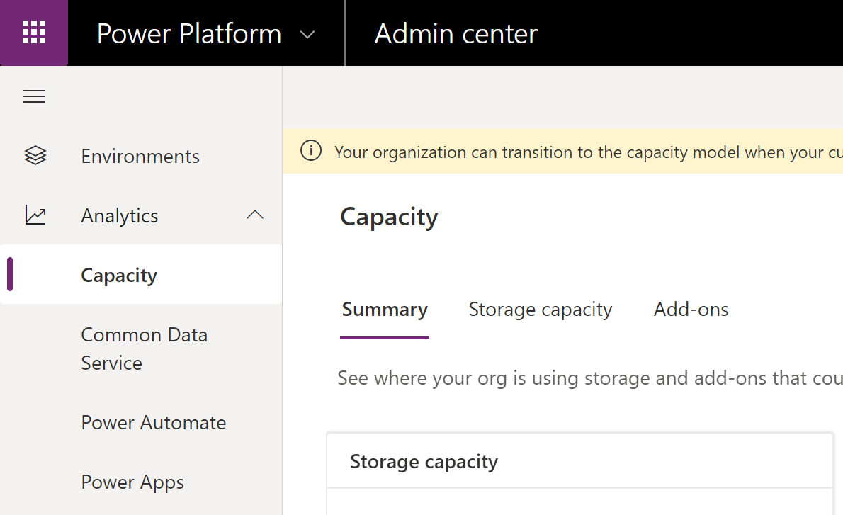
Logs & analytics – see what’s happening
Admin analytics Tenant and environment level analytics Available from Power Platform admin center aka.ms/ppac Access is available for environment admins Data is stored for 28 days Data is refreshed daily
Maker analytics Canvas app and flow level analytics Available from make.powerapps.com and flow.microsoft.com Access is available to app & flow owners (admins can grant themselves access) Data is stored for 30 days Data is refreshed daily
Notes:
CDS is focused on database and model-driven app user activity
Power Apps is targeted toward canvas app
The data is stored only in the region that an environment is hosted in.

Slide 39
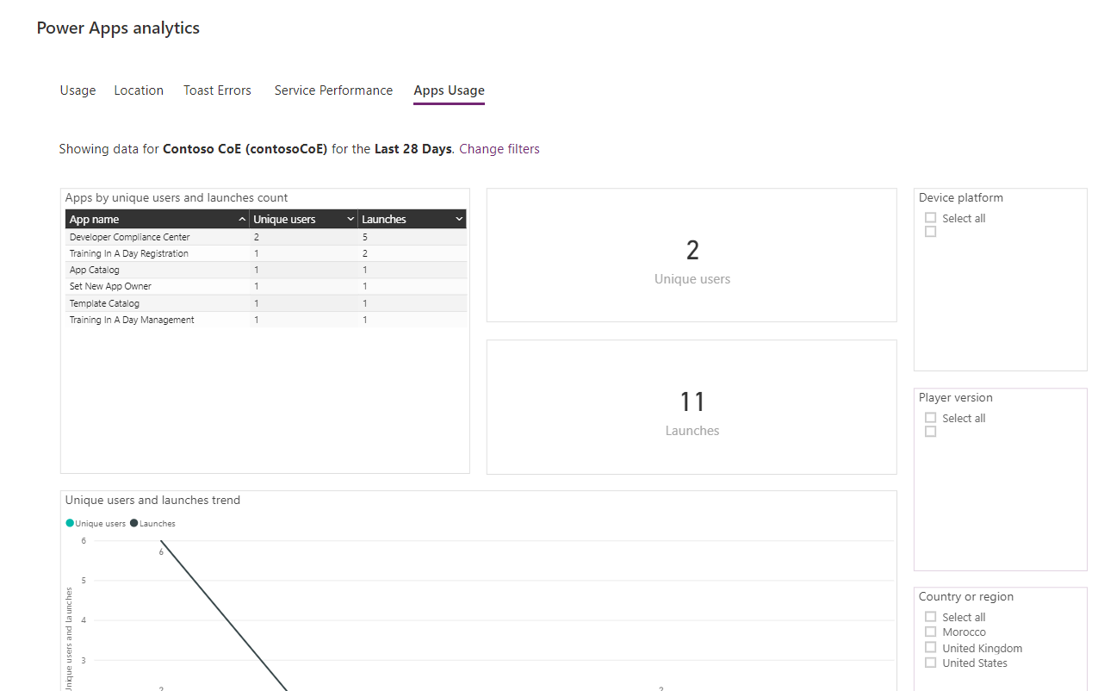
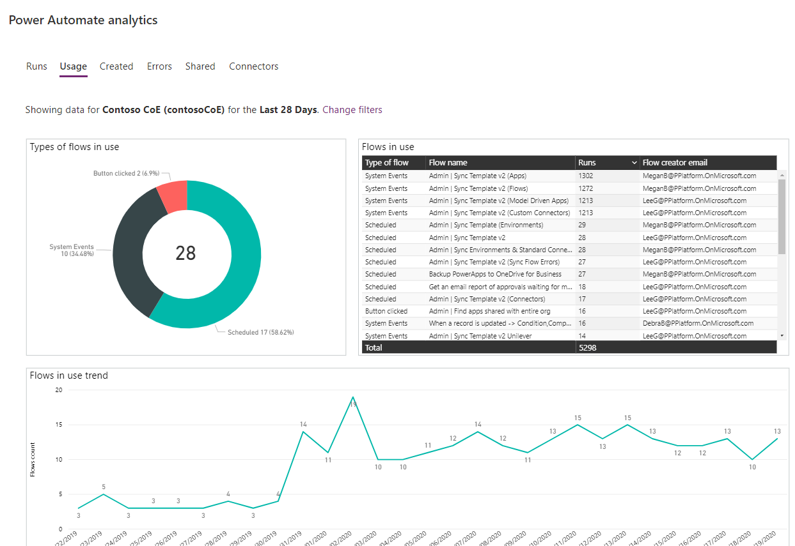
Logs & analytics – see what’s happening

Slide 40
Office Audit

Slide 41
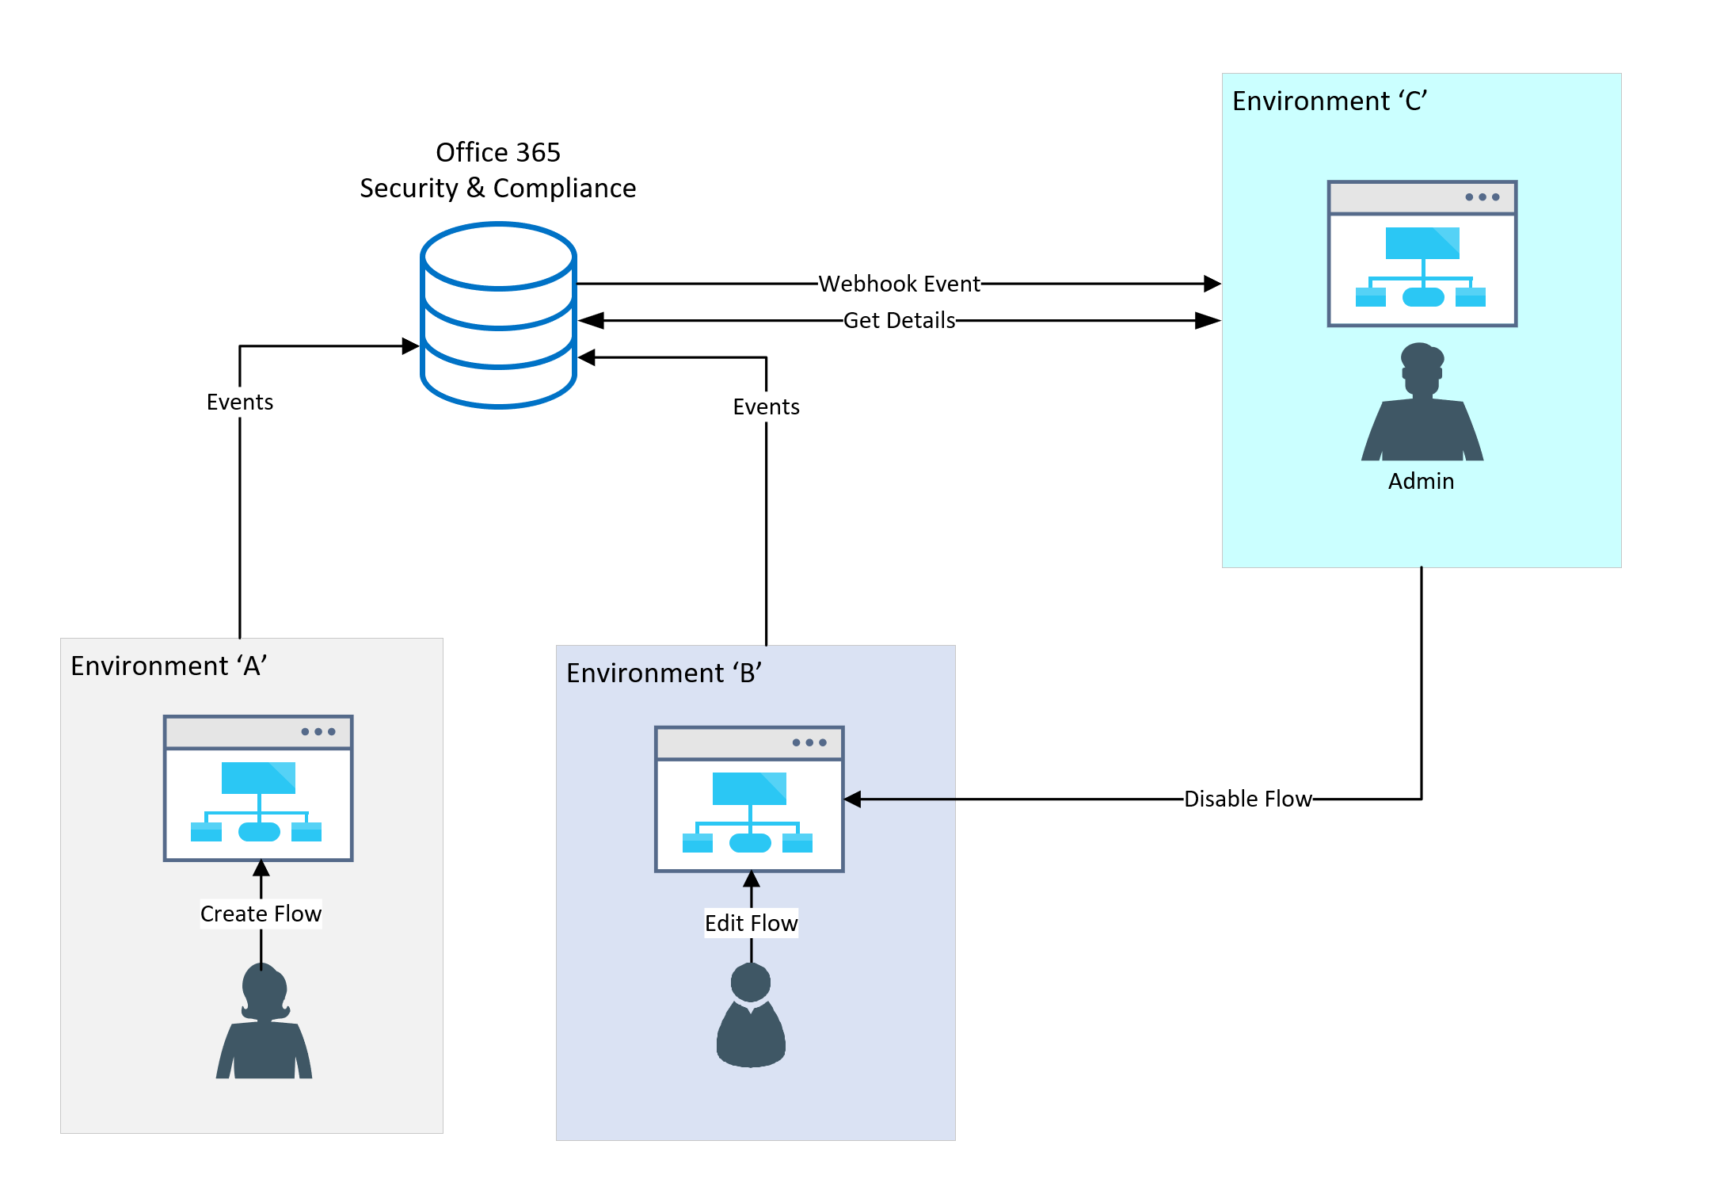
Configure audit logs
Audit log data allows looking at activity that occurred in the platform
Office 365 Activity Logging
CDS Data Activity Logging
Notes:
There are two types of audit logging that can be used to monitor activity in the platform. Office 365 activity logging can be enabled to monitor activity such as creating resources and using resources like flows or canvas apps. This can be used with out CDS being in an environment. CDS audit can be configured to monitor user usage and modification of CDS entities.

Slide 42
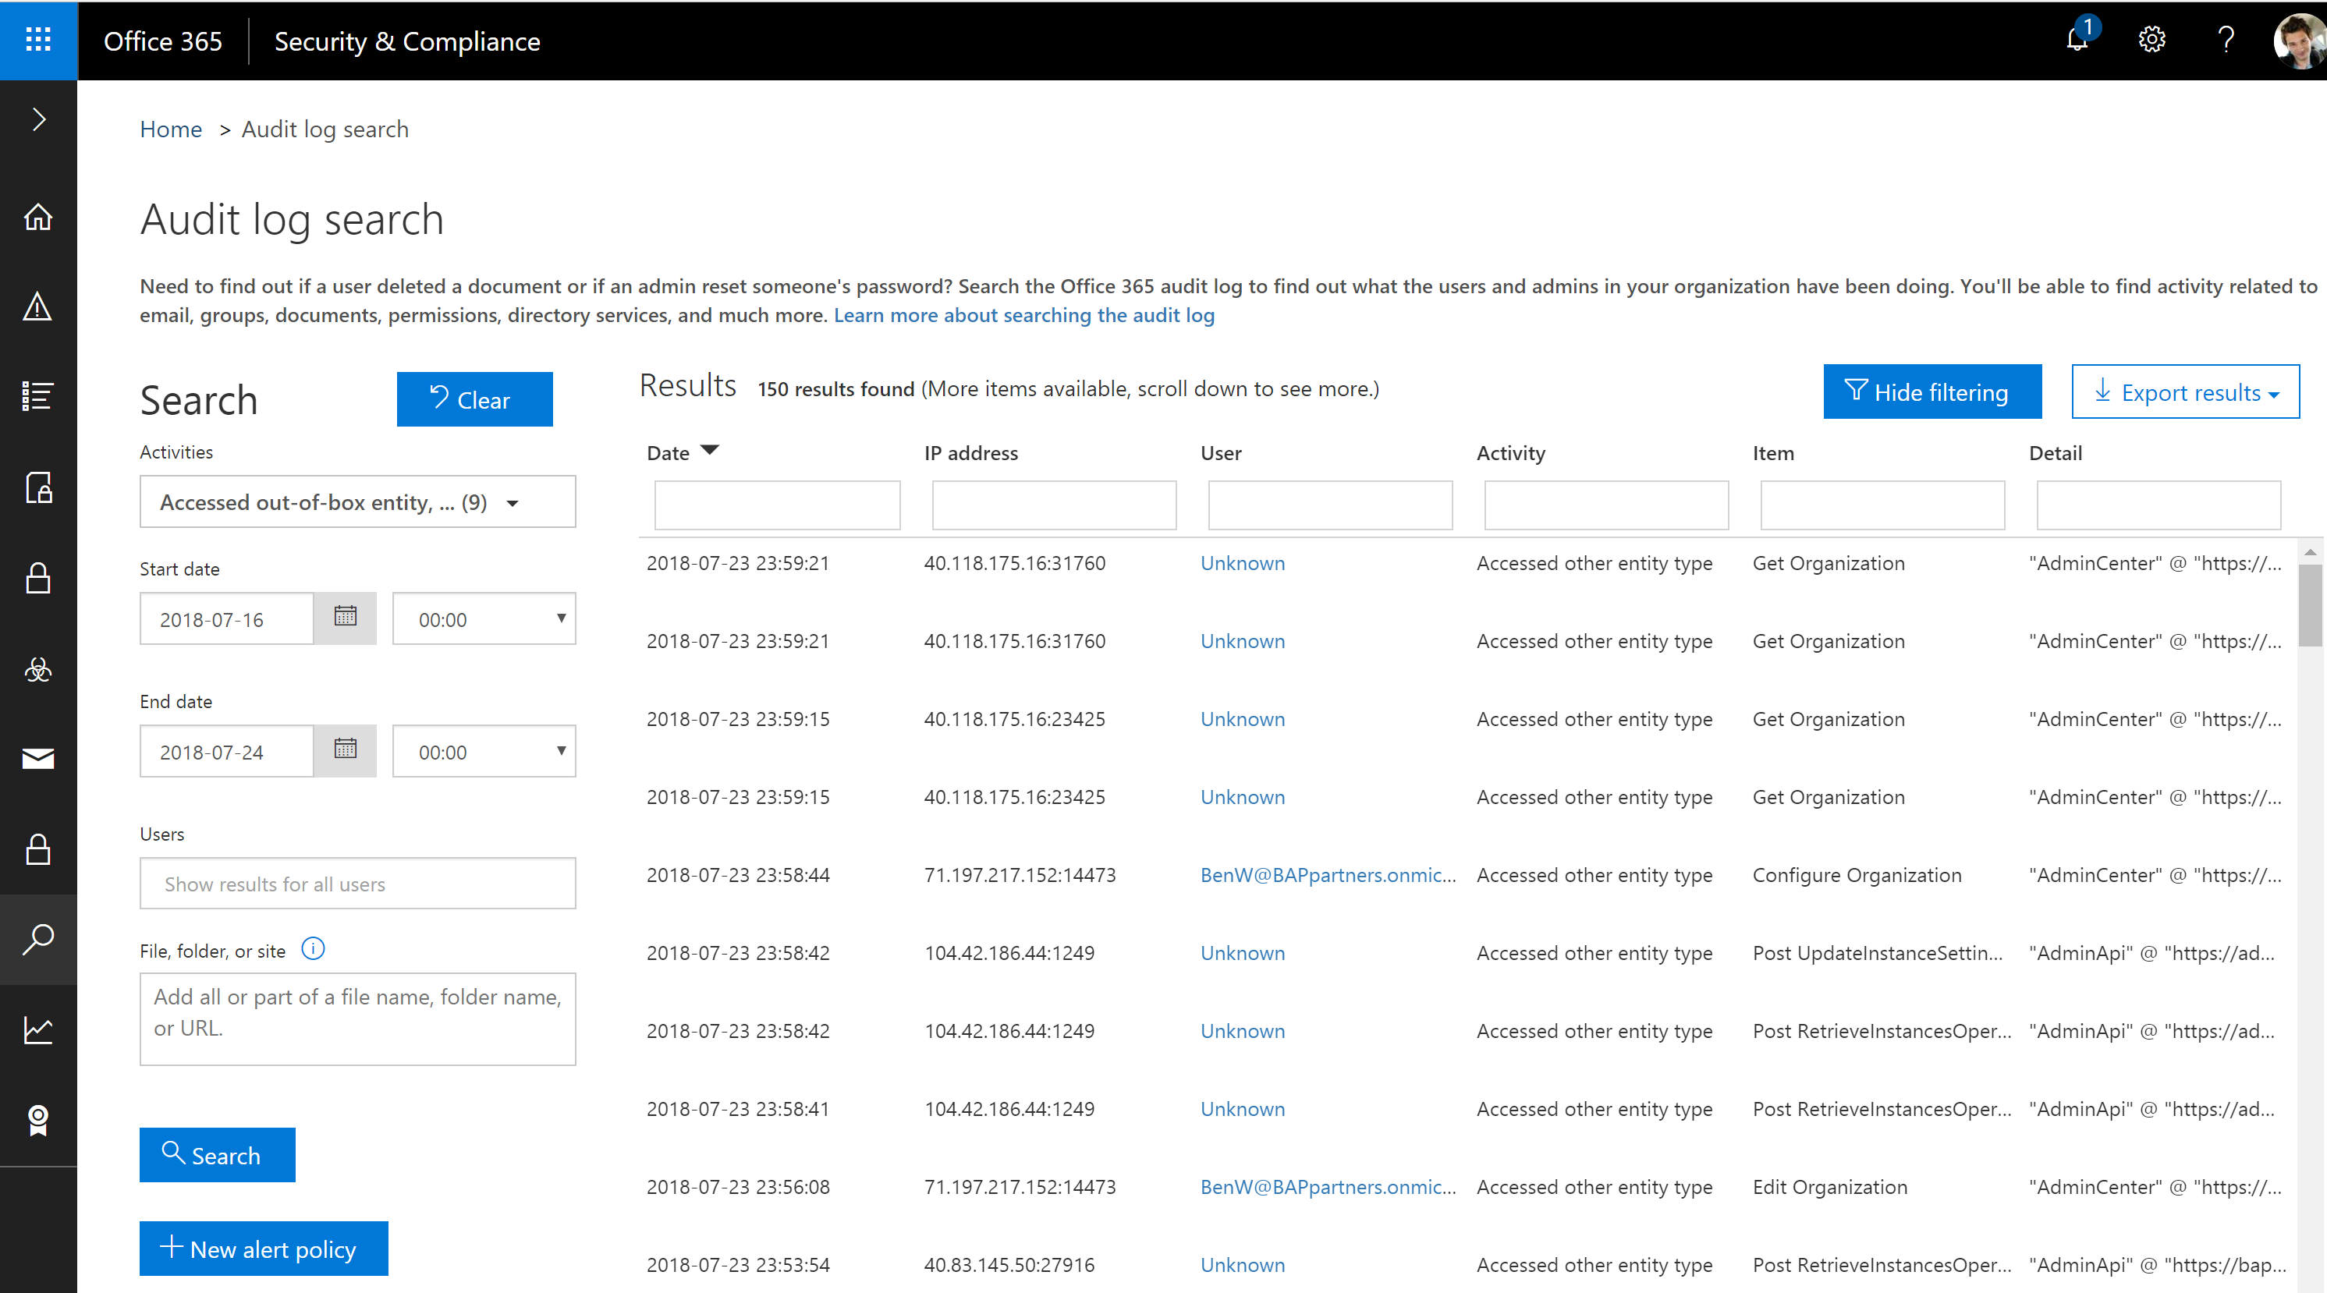
Office 365 Activity Logging
Activity Logging integrated with Office Security and Compliance center for comprehensive logging across Microsoft services
The audit records are stored in Office 365 Security and Compliance center.
Office provides an API to query this data, which is currently used by many SIEM vendors to use the Activity Logging data for reporting
Notes:
SIEM – Security Information and Event Management

Slide 43
Which activity logs are supported?
Power Automate | Power Apps
Created flow Edited flow Deleted flow Edited permissions Deleted permissions Started a paid trial Renewed a paid trial | Created app Edited/save app (draft) Published app Deleted app Restored an app from app version Launched app Marking app as featured Marking app as hero Edited app permissions Deleted app permissions

Slide 44
Logs & analytics – see what’s happening
1. PowerApps and Flow logs available at https://protection.office.com
The audit records are stored in Office 365 Security and Compliance center.
Must have an Office 365 E3 or greater license
Must enabled at the organization level
Office provides an API to query this data, which is currently used by many SIEM vendors to use the Activity Logging data for reporting
Microsoft Flow | PowerApps
Created flow Edited flow Deleted flow Edited permissions Deleted permissions Started a paid trial Renewed a paid trial | Created app Edited/save app (draft) Published app Deleted app Restored an app from app version Launched app Marking app as featured Marking app as hero Edited app permissions Deleted app permissions

Slide 45
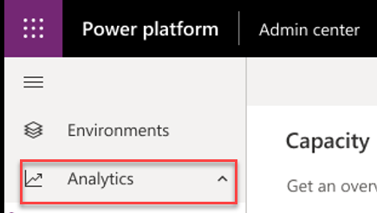
Logs & analytics – see what’s happening
1. PowerApps and Flow logs available at https://protection.office.com
2. Admin analytics available at https://aka.ms/ppac
Tenant and environment level analytics
Available from Power Platform admin center
Access is available for environment admins
Data is stored for 28 days
Data is refreshed daily
Capacity Management
Common Data Service
Microsoft Flow
PowerApps

Slide 46
Enable Office 365 activity logging
Must have an Office 365 E3 or greater license
Must enable at the organization level
Enable-OrganizationCustomization
Set-AdminAuditLogConfig -UnifiedAuditLogIngestionEnabled $true
Non service admins need permissions to view
E.g. Add-RoleGroupMember "Compliance Management" -Member user1
Notes:
https://docs.microsoft.com/en-us/office365/securitycompliance/turn-audit-log-search-on-or-off

Slide 47

Build flows to alert on key audit events
An example of alerting that can be implemented is subscribing to Office 365 Security and Compliance Audit Logs
This can be achieved through either a webhook subscription or polling approach. However, by attaching Flow to these alerts, we can provide administrators with more than just email alerts
Activity Logging Web Svc
Power Apps logs
Power Automate logs
Admin
Power Automate

Slide 48
CDS Auditing
Three level configuration
All custom and most customizable entities can be audited
1. Environment
2. Entity
3. Field
Notes:
You enable or disable auditing at the environment level by setting in the admin portal on the environment. However, for entities and attributes, you set a property value of the entity or attribute metadata.

Slide 49
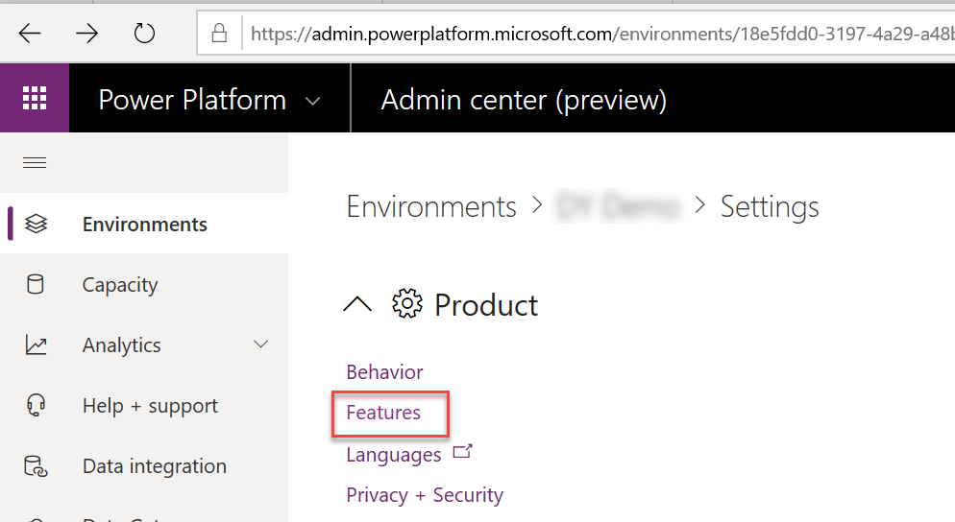
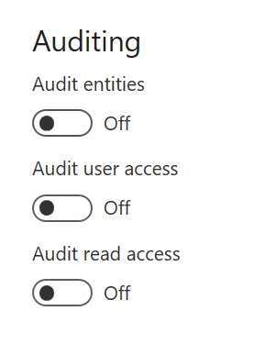
Enable CDS auditing for the environment
Notes:
Audit entities enables tracking of modifications to entity data to be tracked, this data is viewed in the context of the record in CDS
Audit user access and read access logs the data and it shows up in the Office 365 Security and Compliance center with other activity.

Slide 50
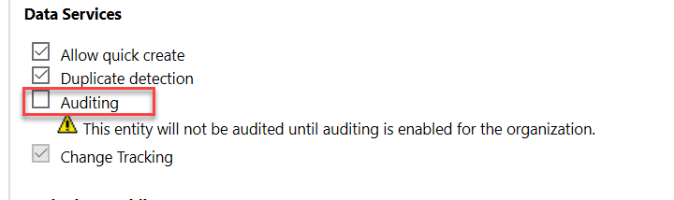
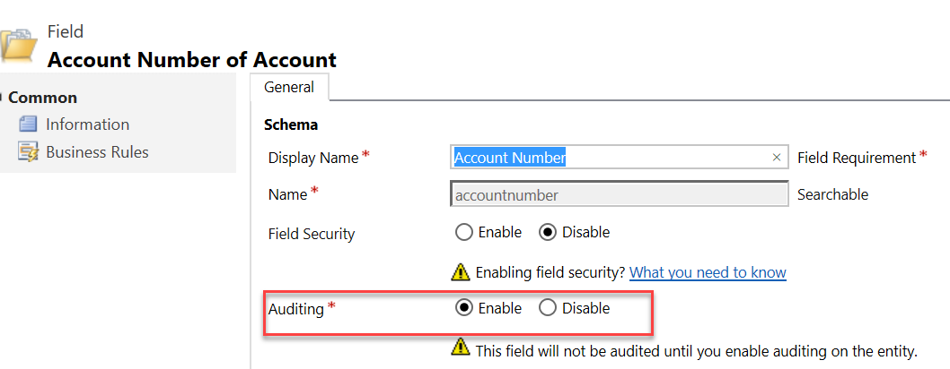
Enable for Entity and Field
Entity Level
Field Level
Notes:
This must be done on classic solution explorer

Slide 51
Alert & act on that activity

Slide 52


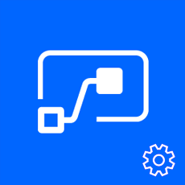

Leverage management connectors & PowerShell as powerful reporting tools + tools for action
The PowerShell Cmdlets give admins full visibility to all activity for PowerApps and Flow in their organization - aka.ms/powerappspowershell.
Management connectors
Full visibility: Power Platform APIs in an accessible connector interface, provide admin access to resources
Customization : Pull the metadata you need to build the custom reports you want
Flexibility: Build the policies you need to implement administration + governance requirements
Power Platform for Admins
PowerApps for Admins
Flow Management
PowerApps for App Makers

Slide 53
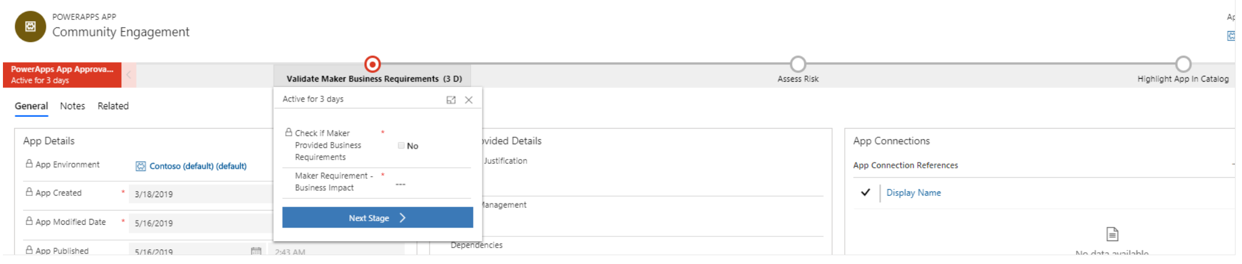
Establish and automate your audit process
Create your own workflows using the management connectors that permit or restrict behavior based on your organization’s policies (e.g. create an attestation process for assets in the default env)
CoE starter kit comes with its own audit workflow template:
Canvas app, flow creation | aka.ms/restrictappcreators
Specific connector usage | aka.ms/restrictflowconnector aka.ms/restrictappconnector
Newly added connectors | aka.ms/newconnectornotification

Slide 54
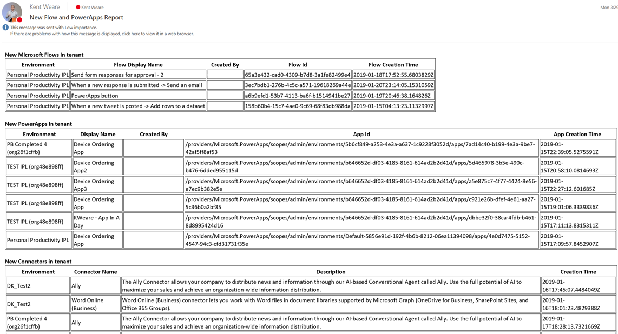
Welcome new makers and identify champions
Welcome new makers
Detect when new flow has been created
Check to see if they are part of makers AAD Group
If new, send welcome email with company and public resources
Invite them to Internal Yammer Club
https://aka.ms/powerwelcomeemail
Identify champions
New Flow, PowerApps and Connectors Digest
Sent Daily
Oversight
Empower new users
https://aka.ms/newmakerdigest

Slide 55
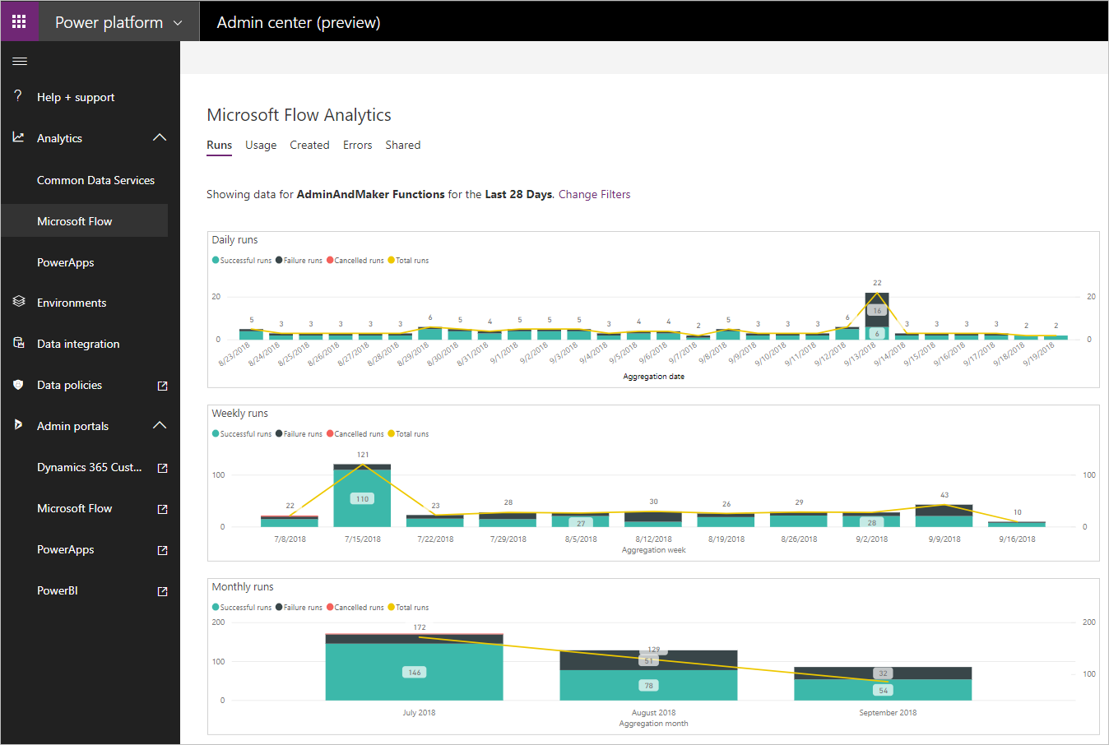
Power Automate Analytics
Usage
Created
Errors
Shared
Notes:
Usage provides insights related to the types of flows that are in use. This includes Button, Scheduled and System Event flows, all broken down by the number of runs and the trend over a configured timeline.
Created provides insight into the different types of flows that have been created. This includes Button, Scheduled and System Event flows, all broken down by the number of runs and a trend over a configured timeline.
Errors provides insights into flows that may be experiencing issues. The errors will be broken down by error type so that you can look for common problems that may exist. This can kick off the discussion with the maker so they can look at the detail for the flow.
Shared provides insight into the flows that have been shared within an environment. Include information will be the type of flow including Button, Scheduled or System Events.

Slide 56
Audit log info
You can have a maximum of 50 audit log retention policies in your organization.
To retain an audit log for longer than 90 days, the user who generated the audit log must be assigned an Office 365 or Microsoft 365 E5 license or have a Microsoft 365 E5 Compliance add-on license.
PowerShell support for Power Apps
https://docs.microsoft.com/en-gb/power-platform/admin/powerapps-powershell
Audit log retention policies
https://docs.microsoft.com/en-us/microsoft-365/compliance/audit-log-retention-policies?view=o365-worldwide

Slide 57
UI Flows
https://docs.microsoft.com/en-gb/power-automate/ui-flows/setup

Slide 58





Robotic Process Automation (RPA)
Power Automate is an intelligent digital
process automation (DPA) service

Slide 59

Bridging Automation Across API and non-API based apps
Non-API apps
Power Automate bridges
automation across systems
Modern Systems

Slide 60



Introducing RPA with Power Automate:
Automate Apps with Robotic Process Automation (RPA) Capabilities
Record the Task
Automate the Task
Execute the Task

Slide 61
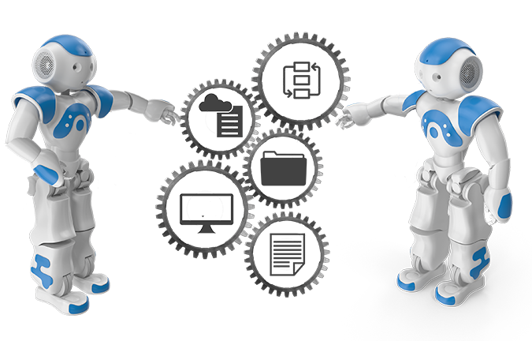
When and why should you use UI Flows?
The target app has no API
The scenario requires to use the user interface
UI Flows (or RPA) for automation is fragile
Changes to the interface can break your flow
Consider creating API’s / Upgrade your apps

Slide 62

Power Automate With Attended and Unattended RPA
Automation whether you’re logged in or not
Attended
Unattended
Interactive acceleration
Human initiated Logged in
High volume back-end processes
Runs automatically
Can log into system or machine
Notes:
https://docs.microsoft.com/en-us/power-automate/ui-flows/run-ui-flow

Slide 63
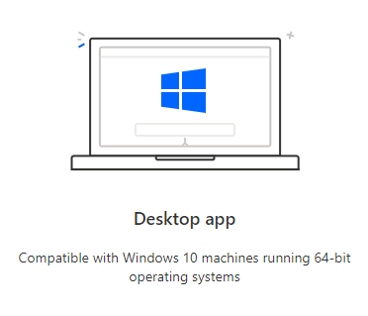
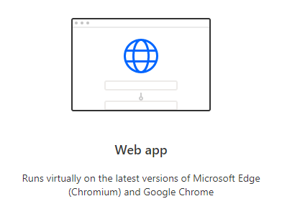
Power Automate for desktop apps or web apps

Slide 64
Prerequisites
A device that runs Windows 10 Pro, Windows Server 2016, or Windows Server 2019.
The Microsoft Edge or Google Chrome browser.
An environment with a Common Data Service database.
Notes:
https://docs.microsoft.com/en-us/power-automate/ui-flows/setup

Slide 65
Limitations
You must have the latest versions of each components to record, test, or run UI flows.
The following are not supported:
Windows 10 Home installations are not supported.
Desktop UI Flows
Multiple monitors
Double click, mouse hover, touch/pen input
Interactions on Windows (File explorer, startup menu, task bar, etc.)
Web UI Flows
Right click
User session information (e.g.: cookies) will not be reused during playback. You will have to edit the script to embed sign in information when required by websites.#

Slide 66
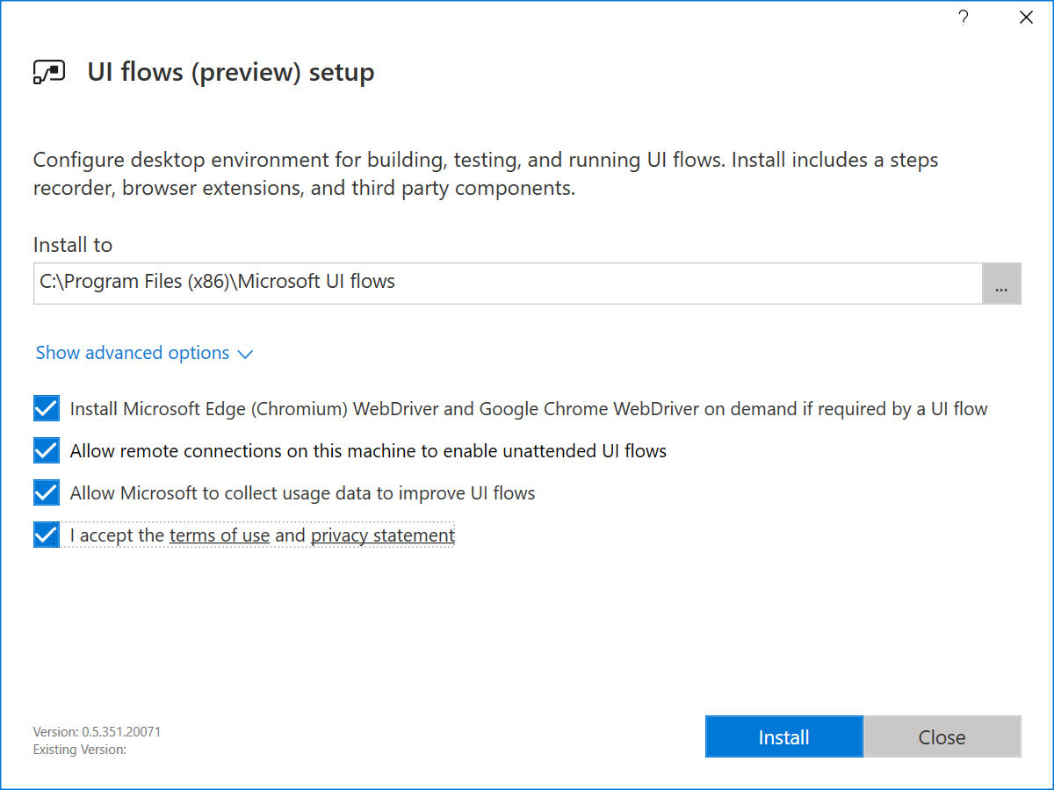
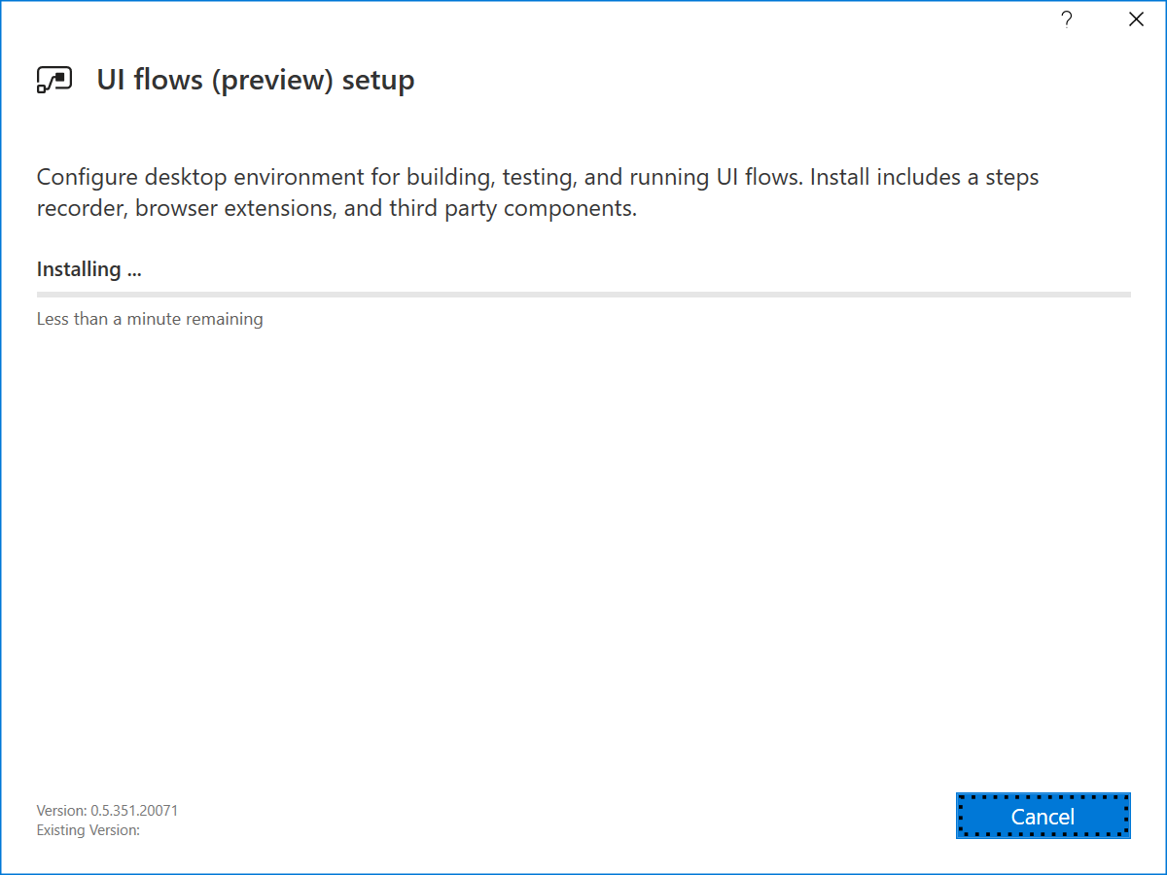
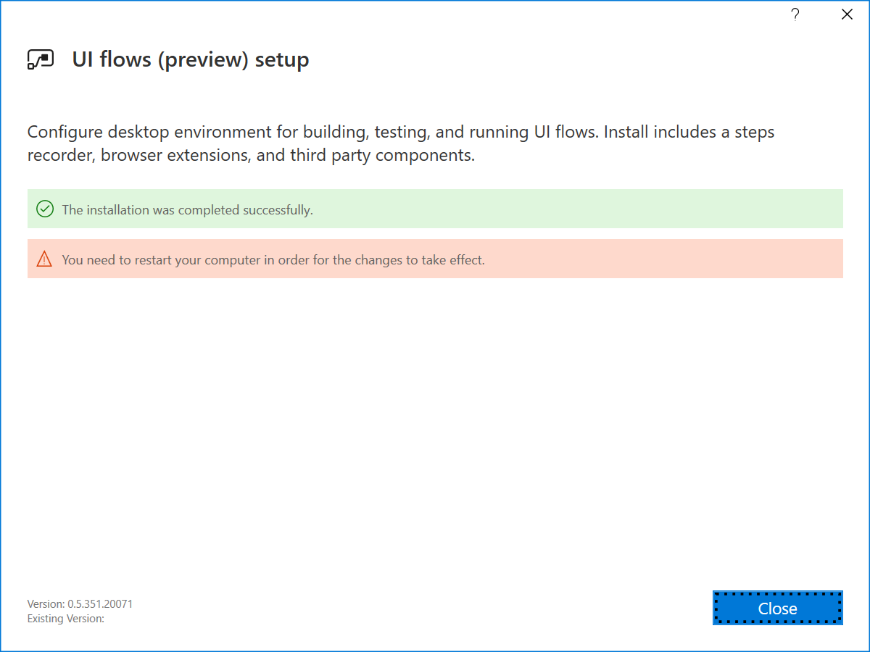
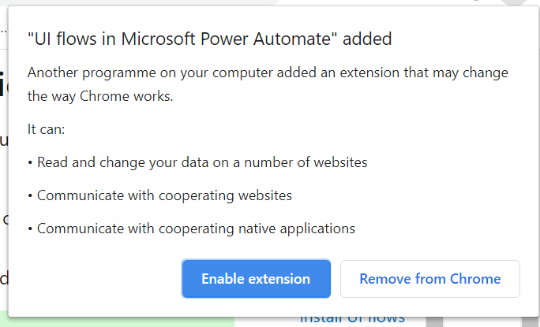
Setup Environment
Install UI flows on your device
Download the UI flows installer
Activate the UI flows browser extension
Notes:
https://docs.microsoft.com/en-us/power-automate/ui-flows/setup

Slide 67
Setup Environment
Install Selenium IDE to automate Web applications
Download and install the Selenium IDE for the next version of Microsoft Edge or Google Chrome.
Install the on-premises data gateway
Recommend
An 8-core CPU
8 GB of memory
A 64-bit version of Windows Server 2012 R2 or later
Solid state drive (SSD) storage for spooling.
Download and install a standard gateway
Notes:
https://docs.microsoft.com/en-gb/data-integration/gateway/service-gateway-install

Slide 68

Demo

Slide 69
Best Practices

Slide 70
Best Practices for Flow Authoring
Rename action cards
Add comments
Don't touch production, work on a copy!
Prototype with button triggers
Iterate – build your flow one piece at a time
Use variables/compose to simplify checks & conditions
Keep it simple

Slide 71
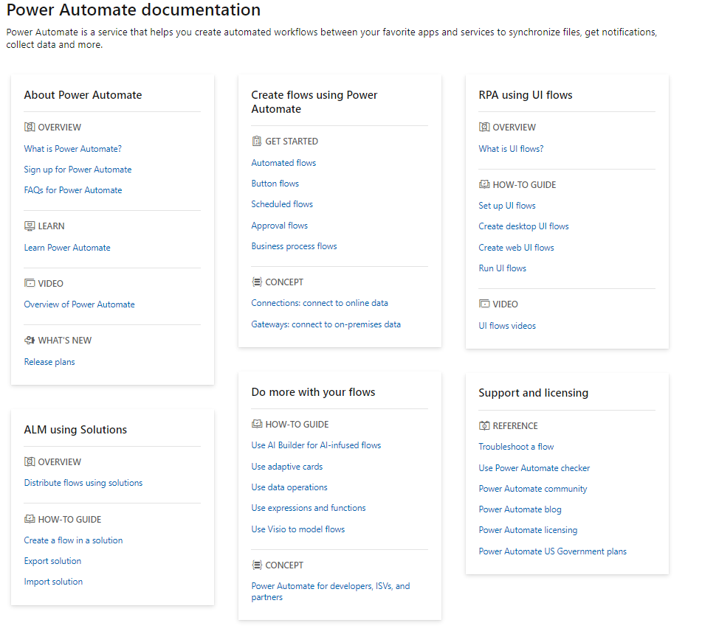
Reference
https://docs.microsoft.com/en-gb/power-automate/

Slide 72
Customer Stories
Questions

Slide 74






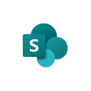





Jenkins NS
Modern Workplace Solution Architect | Consultant
Microsoft Teams, Power Platform and SPFx Specialist
International Speaker | Blogger | Trainer
SPS Bangalore Organizer
aOS Ambassador
jenkinsns@gmail.com
in/jenkinsns
@jenkinsns
http://www.jenkinsblogs.com
jenkinsns
https://www.facebook.com/spfxinfo/
https://www.facebook.com/msteamsinfo

